Slide 1
ManuTech III
Process Control - Introduction
Syllabus
Flowsheeting, Flow Diagrams
Material and Energy Balances
Unit operations
Heat exchangers
Distillation columns
Crystal Structures
1

Slide 2
Class Schedule
Two lectures with Adrienne
Two hours a week with me:
Monday 13:00 room TN-301
Tuesday 14:00 room 142
Have tutorial once every two weeks
Labs Tuesday 10:00 room 116
2

Slide 3
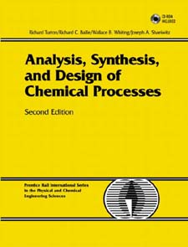
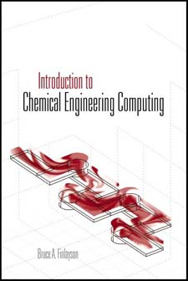
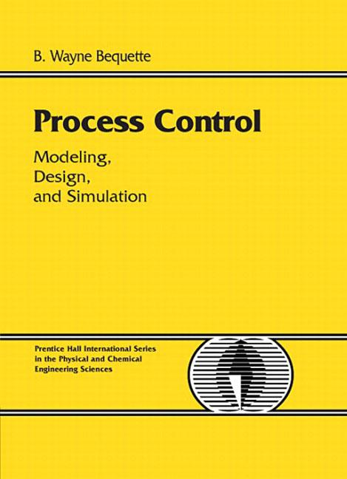
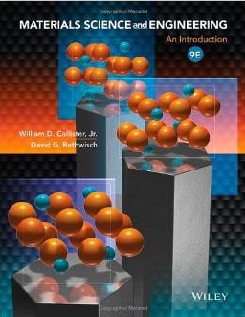
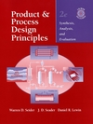
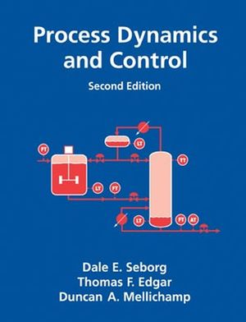
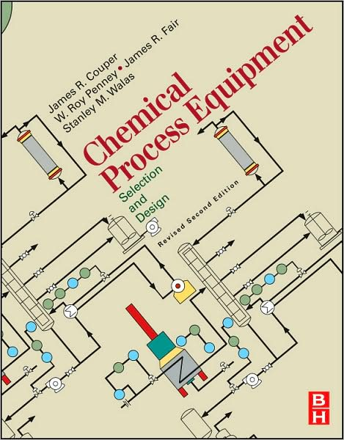
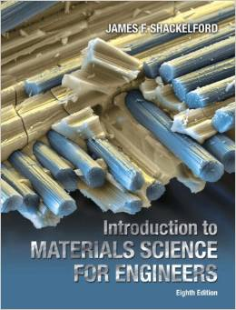
TextBooks
Analysis, Synthesis, and Design of Chemical Processes, Second Edition, by Richard Turton
Chemical Engineering Computing by Finlayson
Product and Process Design Principles, Second Edition, by Seider, Seader, & Lewin
Process Dynamics and Control, Second Edition, by Seborg, Edgar, & Mellichamp
Process Control, by Bequette
Chemical Process Equipment, Couper, Penney, Fair & Walas
Materials Science and Engineering, Callister
Materials Science for Engineers, Shackelford
Books expensive, but look on books.google
3

Slide 4
Assessment
January Exam – 50%
Common paper for Adrienne and me
Midterm – 15%
10% for Adrienne’s ½ of course
5% for Process Technology ½
Series of multi-choice online quizzes
Labs – 35%
4

Slide 5
Brightspace
You're enrolled already
5

Slide 6
Brightspace
brightspace site contains:
Course announcements
Lecture notes
Past papers
Tutorial Sheets
CA Quizzes
Upload points for lab write-ups
Same brightspace site for both Adrienne and Eugene
6

